Slide 1
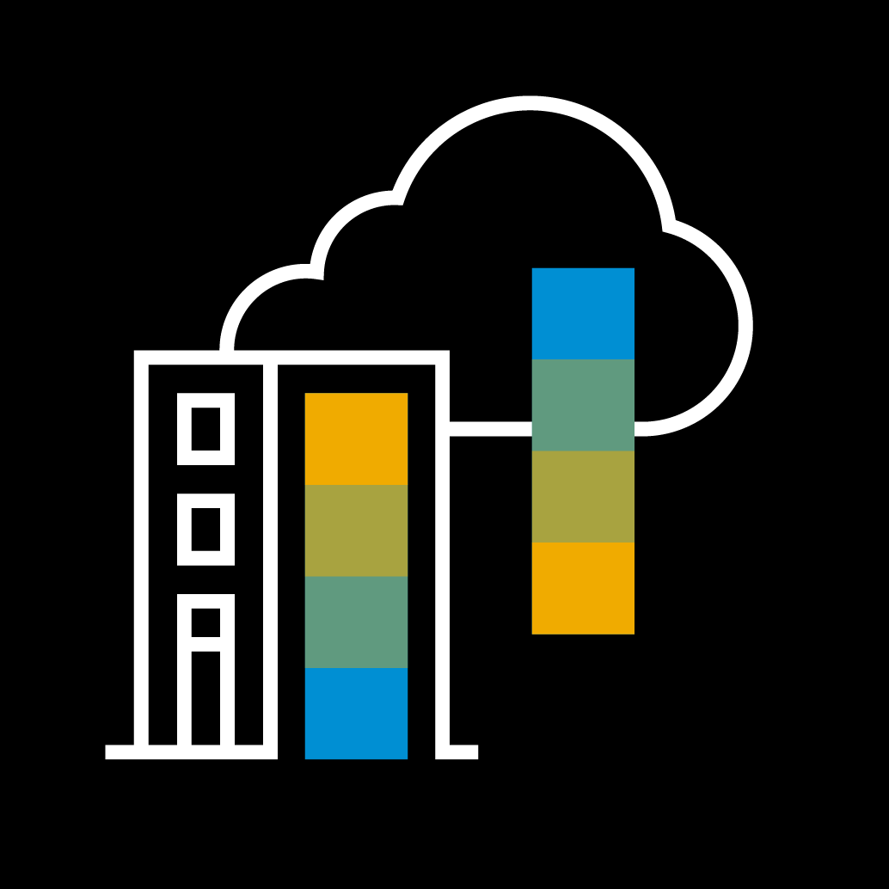
Devops Community Chapter 2 Czyli: jak przestałem klikać I pokochałem automatyzację

Slide 2
Devops Community Chapter 1 – building docker containers
Devops Community Chapter 2 – provisioning and orchestration
Notes:
Poprzednio budowaliśmy kontenery, teraz koncentrujemy się na kolejnym etapie. Zakładamy że aplikacja jest już zbudowana – w formie dockerowego kontenera

Slide 3
Agenda
Evolution of deployment mechanisms
From servers to containers
From containers, where?
Kubernetes automatization
Smarter deployments
Autoscaling
Helm – deploying simple
How to automate the automat?
Notes:
Krótki rys historyczny, dlaczego wogóle wybieramy k8s I kontenery
Smarter deployments - jak zarządzać deploymentowmi
Autoscalling – jeśli możemy łatwo zarządzać to możemy pomyśleć o ciekawych żeczach taki jak skalowanie
I bardzo fajny temat na sam koniec – helm – manager pakietów do k8s

Slide 4
In VM world
Notes:
Build vm image with packer, create different formats for different providers, use vagrant to spin up the environment

Slide 5
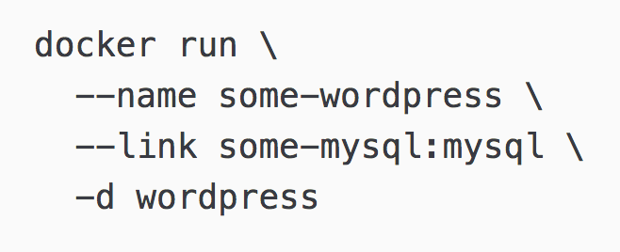
Docker
Can get a bit hard to maintain

Slide 6
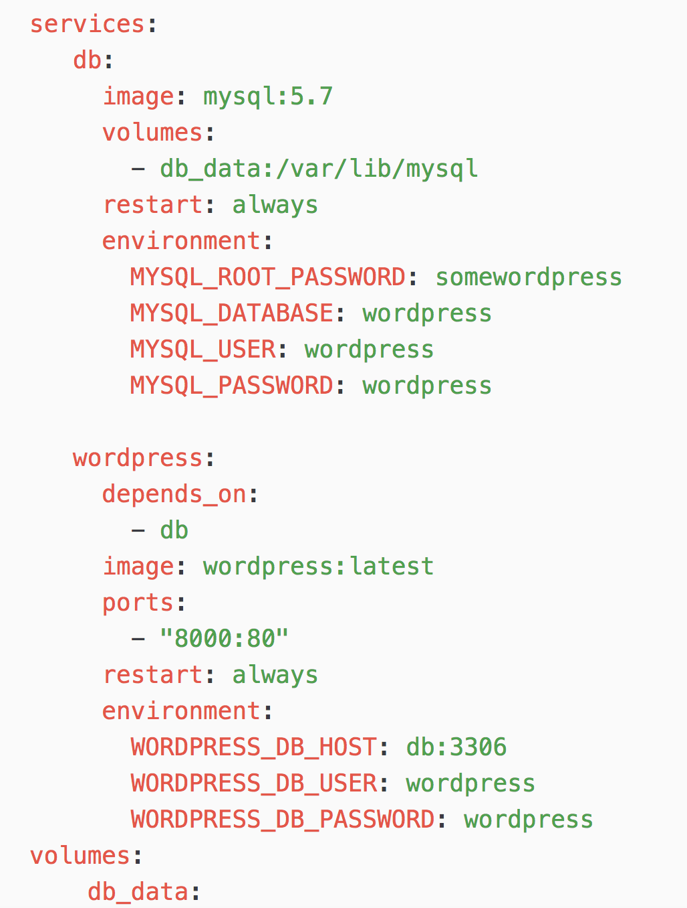
Docker Compose
When you only care about one instance* on one node then this is your solution
*of your whole application – it can include many services

Slide 7
Container orchestration
K8S
Mesos/Marathon
Docker Swarm

Slide 8
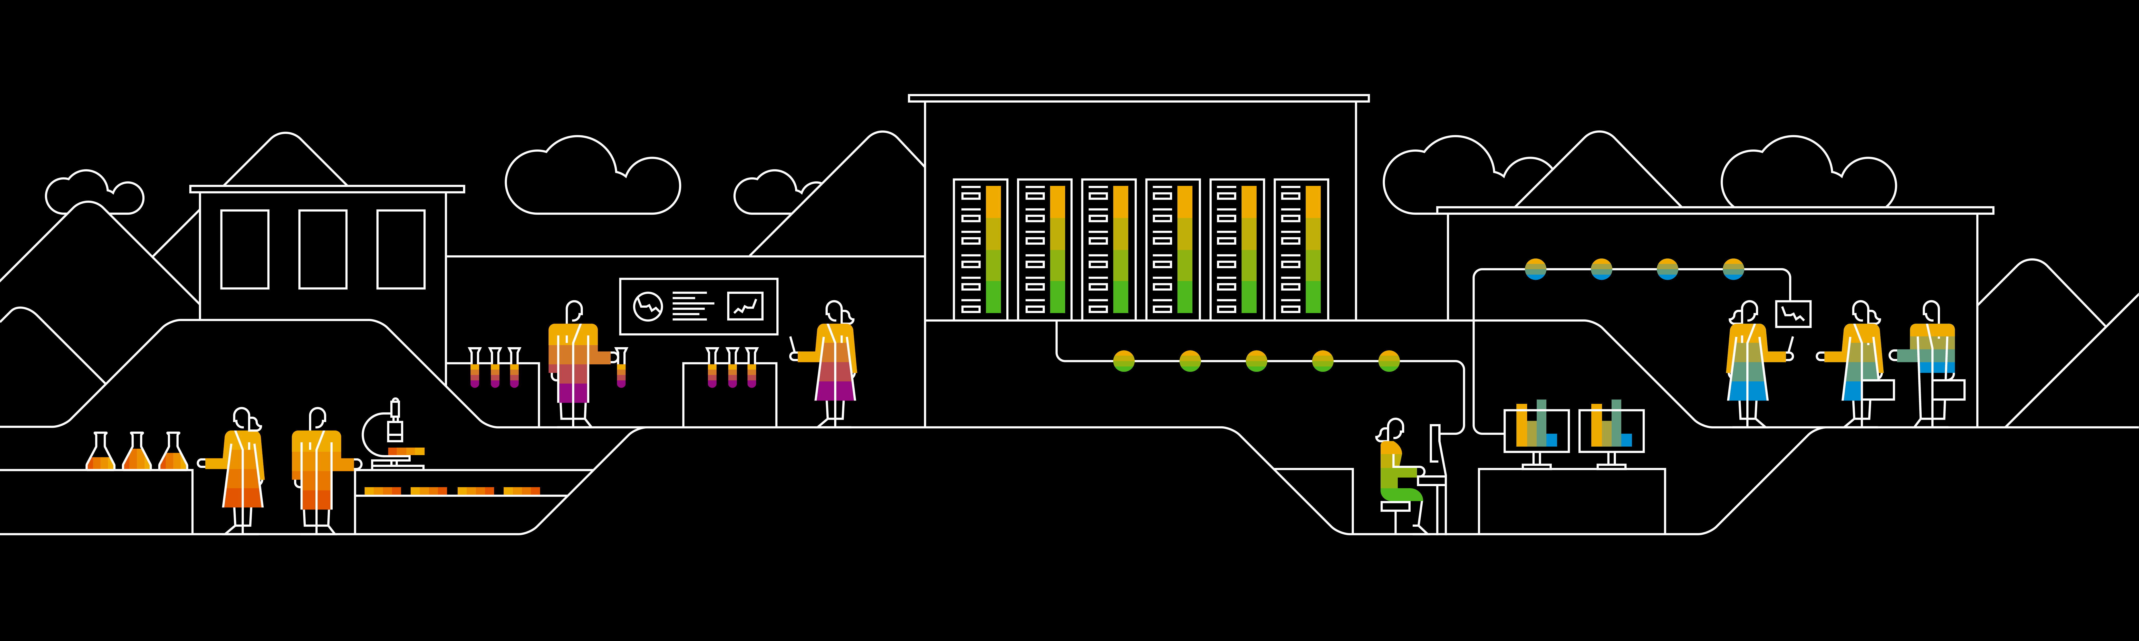
Divider page

Slide 9
Smarter deployments in Kubernetes

Slide 10
Slajdy od Tomków
First level
Second level
Third level

Slide 11
Helm – The package manager for Kubernetes

Slide 12

What is Helm?
„ Helm is a tool that streamlines installing and managing Kubernetes applications. Think of it like apt/yum/homebrew for Kubernetes.”
Helm has two parts: a client (helm) and a server (tiller)
Tiller runs inside of your Kubernetes cluster, and manages releases (installations) of your charts.
Helm runs on your laptop, CI/CD, or wherever you want it to run.
Charts are Helm packages that contain at least two things:
A description of the package (Chart.yaml)
One or more templates, which contain Kubernetes manifest files

Slide 13
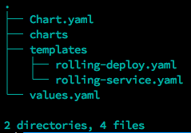
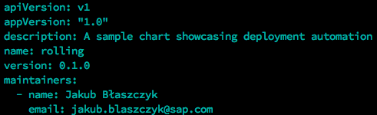
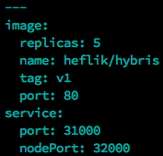
Example Chart structure
Chart.yaml – Metadata of the chart (name, version, maintainers)
Charts directory – Your local dependencies
Templates directory – Your code: kubernetes manifests + go based templates
Values.yaml – Your default values.

Slide 14
The helm repo
Official helm repository: https://github.com/kubernetes/charts
Github based repositories: https://github.com/kubernetes-helm/monocular/tree/master/deployment/monocular
Support for private repositories: http://helm-repository.yrd.rot.hybris.com/

Slide 15
Lets improve the previous deployments

Slide 16
Some more advanced examples

Slide 17
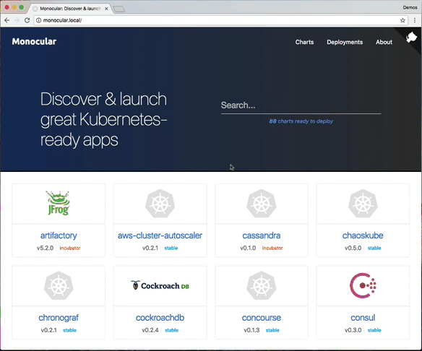
Monocular – The helm WebUI
View avaliable charts (official and private repos)
View running deployments
Install & delete deployments

Slide 18
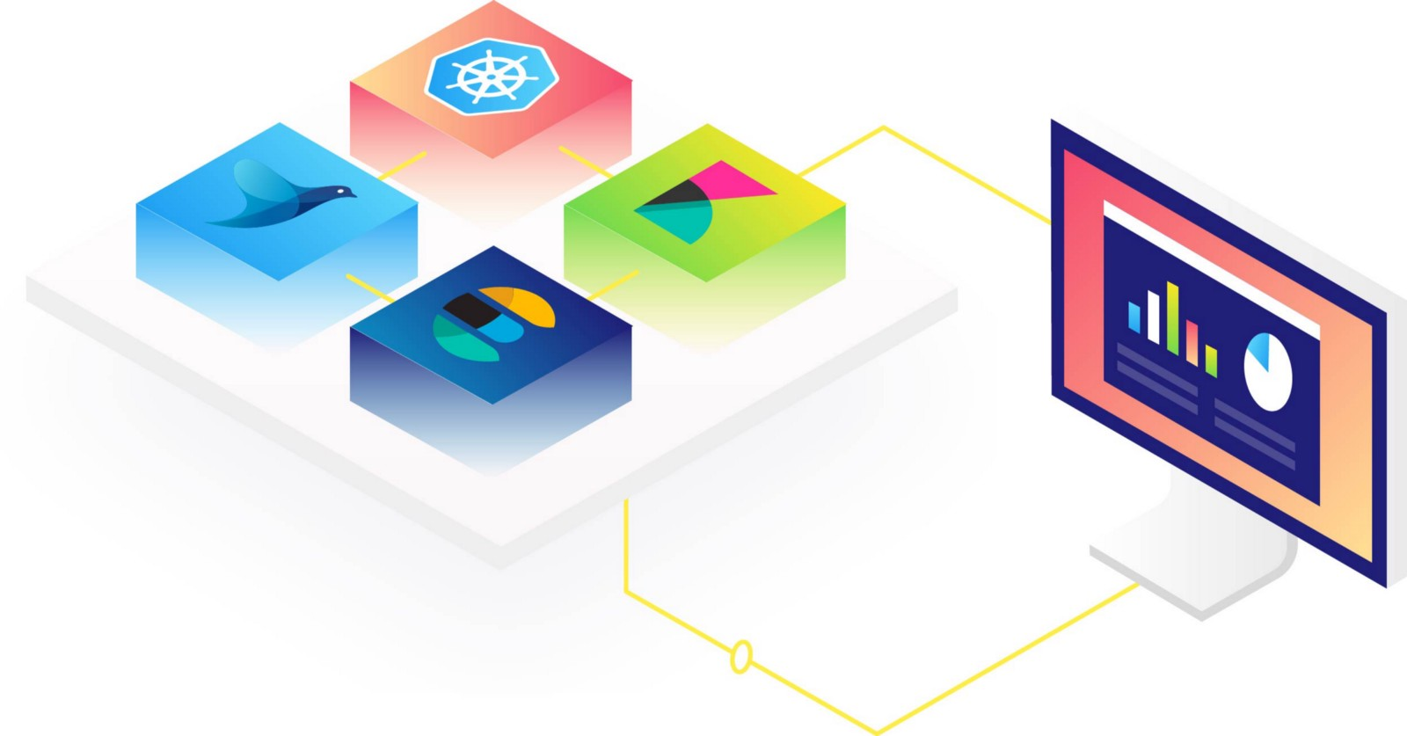
EFK – Complete logging solution
Our custom build solution
Enables log aggregation and analytics for cluster
Access to kubernetes metadata (manifest labels, node labels, docker info)

Slide 19
Thank you.
Partner logo

